Slide 1

A Project Review Meeting on Flight Status Tracker
By
Name Abhiram.k roll 2520030357
Name V.Akhil roll 2520080029
Team Number: 1
Under the guidance of
D Pavitra
Associate Professor
Department of Computer Science and Engineering
Koneru Lakshmaiah Education Foundation (Deemed to be University estd. u/s. 3 of the UGC Act, 1956) Off-Campus: Bachupally-Gandimaisamma Road, Bowrampet, Hyderabad, Telangana - 500 043. Phone No: 7815926816, www.klh.edu.in

Slide 2
Outline of the Presentation
Abstract
Introduction
Problem Statement
Project Flow Diagram
Objectives with Justification
Modules[Frontend web pages]
Expected Outcomes of the Proposed Work
Conclusion
References

Slide 3
Introduction
Air travel has become one of the most important modes of transportation, making accurate and timely flight information essential for passengers, airlines, and airport authorities. Flight delays, schedule changes, and gate updates can significantly impact travel plans, creating a need for efficient flight tracking systems. web-based Flight Status Tracker developed to provide users with real-time flight information through a simple and interactive interface. The application allows users to search for flights, view flight status, check departure and arrival details, monitor routes, and access recent search history.By leveraging modern web technologies and API integration, SkyTrack aims to enhance the user experience by delivering reliable, fast, and accessible flight information on both desktop and mobile devices.

Slide 4
Abstract
Flight Status Tracker application that provides real-time flight information through a modern and user-friendly interface. Users can search for flights, view live status updates, check departure and arrival details, track routes, and access recent search history. The system is developed using web technologies such as HTML, CSS, JavaScript, and REST APIs to deliver accurate and responsive flight tracking services. The project aims to enhance passenger convenience by providing quick and reliable access to flight information.

Slide 5
Problem Statement
Passengers need quick and reliable access to real-time flight information. Flight status updates, delays, gate changes, and schedule modifications are often difficult to track efficiently. There is a need for a centralized and user-friendly flight tracking system. The system should provide flight search, live updates, notifications, and accurate flight details in one platform.

Slide 6
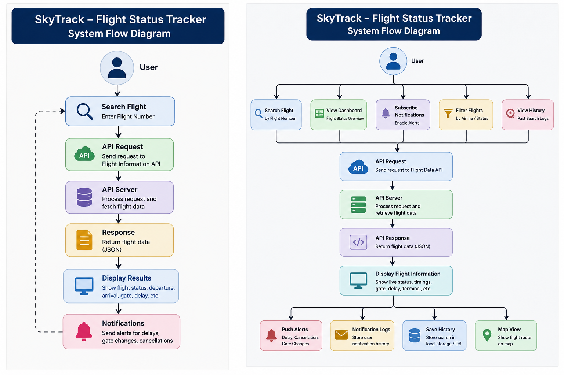
Project Flow Diagram

Slide 7
Objectives with Justification
Objective 1: Provide Real-Time Flight Tracking
Justification: Passengers require up-to-date flight information to plan their travel efficiently and avoid inconvenience caused by delays or schedule changes.
Objective 2: Enable Quick Flight Search
Justification: Users should be able to retrieve flight details instantly using a flight number, reducing the time spent searching across multiple platforms.
Objective 3: Display Comprehensive Flight Information
Justification: Providing departure, arrival, airline, route, and status details in one place improves user convenience and decision-making.
Objective 4: Support Notifications and Alerts
Justification: Automatic alerts for delays, cancellations, and gate changes help users stay informed without continuously checking flight status.
Objective 5: Maintain Search History
Justification: Storing recent searches allows users to quickly access previously viewed flight information and enhances user experience.

Slide 8
Modules [Frontend web pages]
CO | Topics Used in Project
CO1 | Component-based UI structure, Responsive Design, Separation of HTML, CSS & JS
CO2 | ES6+ Features, Arrow Functions, Template Literals, Async/Await, Array Methods
CO3 | Not Applicable (React Components, Props, State, Hooks not used)
CO4 | API Integration (AviationStack API), Async Data Fetching, UI Updates, Local Storage
CO5 | Input Validation, Responsive UI, User-Friendly Interface
CO6 | Not Applicable (No Testing, CI/CD, Build Tools or Deployment)

Slide 9
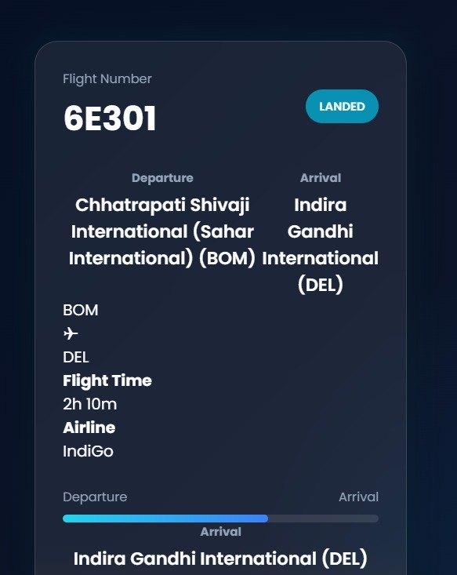
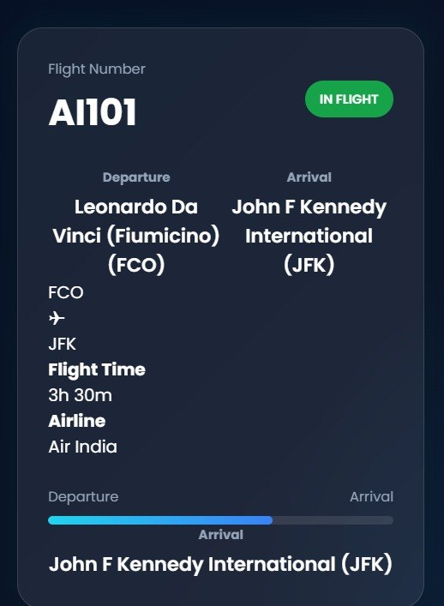
Expected Outcomes of the Proposed Work

Slide 10
Conclusion and Future Scope
Conclusion
Flight Status Tracker is a web-based application developed to provide users with quick and reliable access to flight information. The system enables users to search for flights, view real-time status updates, access departure and arrival details, and receive important notifications related to their journey.The project successfully demonstrates the use of modern web technologies and API integration to create an efficient, user-friendly, and responsive flight tracking platform. By centralizing flight information in a single interface, enhances user convenience and improves access to accurate flight data.

Slide 11
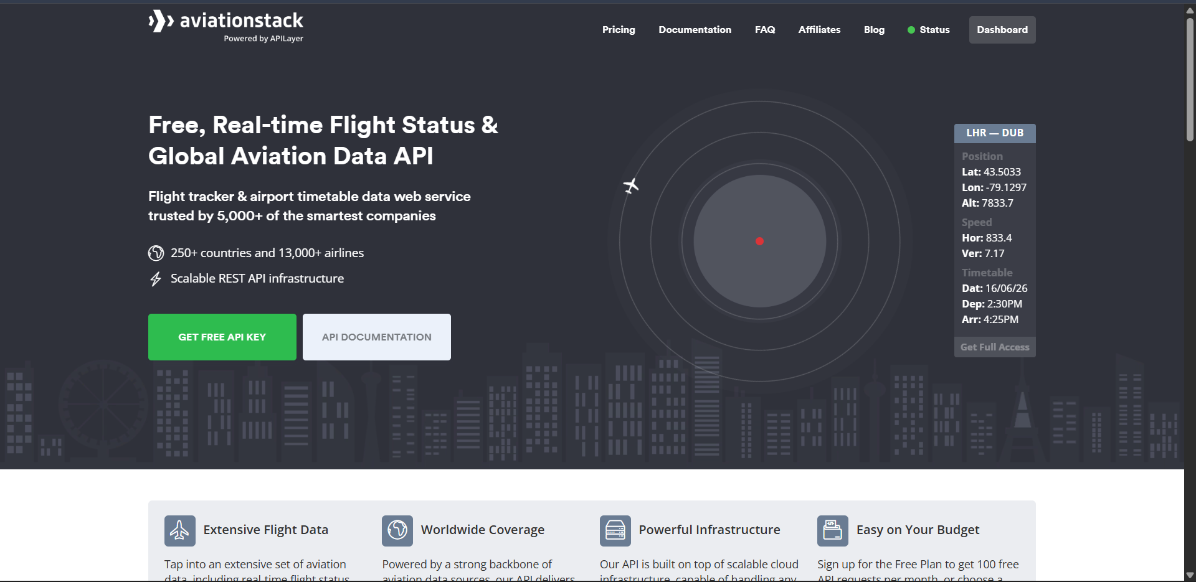
References

Slide 12
Thank you

